Slide 1
KOKO Mobile App Strategy
By Kyrellos Nyawallow

Slide 2
Introduction
Objectives
Approach
KOKO Operations
KOKO Mobile Applications
Operational Functional Gaps
Mobile App Pain-points
Mobile App Requirements
Mobile App Recommendations
New Mobile App Proposals
Roadmap Proposals

Slide 3

Introduction
The KOKO mobile app ecosystem has so far been developed based on a feature-based approach, where mobile apps have been developed based on ad hoc requirements and scaled as business requirements have changed, but without a proper long term strategy or alignment with long term business goals.
This has resulted in a huge functional gap between business needs and mobile application availability to KOKO businesses and users.
This project therefore intends to identify essential KOKO Networks operational requirements for mobile applications, map the current mobile ecosystem, identify user pain-points and identify operational functional gaps.
The subsequent outcome will inform new mobile applications, as well as improvements to existing mobile applications. This will provide a framework for creating a mobile application development roadmap for the next year.

Slide 4
Objectives
The overarching objective of this project is to develop a proposed mobile application development strategy for KOKO Networks for the next year. The project is intended to provide a deep understanding of the mobile application requirements of each KOKO operation, and to use this information to propose new mobile applications for development in order to fill any operational functional gaps that can be addressed by mobile applications; as well as proposed improvements to the existing KOKO mobile applications.
Other objectives include:
Understanding the overall structure and functions of KOKO operations
Understanding the current KOKO mobile application landscape
Documenting the mobile applications used by KOKO operations
Documenting the mobile application pain-points of KOKO operations
Documenting the functional gaps in KOKO operations that might require mobile applications

Slide 5
Approach
The approach is to first get a high level view of KOKO Kenya operations. This encompasses their overarching goals, operational roles and team structure. This information would be used as a basis for understanding operational roles employing mobile applications, or in need of some. Information collection is conducted through stakeholder interviews, as well as KOKO documentation.
The second step is to use this information to get a clear view of the mobile applications in use by the operational teams, as well as their user pain points. This information would then be used to make mobile application improvement recommendations. This information is collected through stakeholder interviews, KOKO documentation and external sources such as the Google Play store.
The third step is to identify the functional gaps within KOKO operations that would be filled by employing the use of mobile applications. The information gained from this would be useful in determining mobile application requirements, and for making recommendations on new mobile applications to be developed. This information is collected through stakeholder interviews, as well as KOKO documentation.
Finally, all the synthesized information would inform the prioritization of proposed mobile applications, as well as proposed improvements of existing mobile applications. Prioritization is based on criticality of the operational requirement for such an operation, determined in consultation with relevant stakeholders.
[PROJECT PLAN HERE]

Slide 6
KOKO Operations
KOKO user groups in scope have been identified on the operations level.
These KOKO operations are listed below:
Network Operations
Fuel Operations
Cooker Operations
Customer Sales
Customer Care
Agent Network

Slide 7
KOKO Operations
KOKO Kenya Operations Hierarchy
KOKO Kenya
Commercial
Operations
Customer Sales
Network Operations
Customer Care
Fuel Operations
Agent Network
Cooker Operations

Slide 8
KOKO Operations
1. NETWORK OPERATIONS
KOKO Network Operations is responsible for managing the KOKOpoint network. It is responsible for production of network infrastructure, commissioning and decommissioning of KOKOpoints.
Network operations encompasess the following:
Production operations
Production Ops is tasked with the production of network hardware including Smart Depot System (SDS), Smart Tanker System (STS), KOKOpoints (KPs), and KOKO cooker kits. They also conduct Quality Control (QC) and Quality Assurance (QA).
Deployment operations
The Deployment Ops team is responsible for the following agent shop inspections, Civil Works to prepare for KP installation, installing KPs in Agent shops, setting up Smart Tanker Systems (STS) in KOKO tankers, and setting up Smart Depot Systems (SDS) in Vivo Energy fuel depots.
Quality assurance operations
Quality (calibration) team is responsible for ensuring that KPs are correctly adjusted to dispense fuel correctly. After a KP is installed in an Agent’s shop, it is fueled by the Fuel ops team. After this, the calibration team does adjustments to ensure it is ready to dispense fuel.

Slide 9
KOKO Operations
2. FUEL OPERATIONS
KOKO Fuel operations is responsible for delivering quality fuel to KOKO fuel customers. It leverages the use of custom technology to facilitate this function. There are 3 players involved in the operation:
Vivo Energy
Vivo Energy is responsible for sourcing ethanol fuel on behalf of KOKO Networks. The imported fuel is stored at the Vivo depot in Mombasa, while local reserves are stored at Vivo petrol station depots.
Transporters
KOKO Networks employs the service of external contractors for transporting fuel from Vivo depots to KOKO agent shops for refilling KOKOpoints (KPs). These contractors use micro-tankers to transport fuel. KOKO Networks also operate their own fleet of micro tankers.
KOKO Networks
KOKO Networks acquires ethanol fuel from Vivo Energy and uses Smart Depot System (SDS) and Smart Tanker System (STS) technology to manage fuel distribution of fuel to KOKOpoints.

Slide 10
KOKO Operations
3. COOKER OPERATIONS
KOKO Cooker Operations is responsible for storing, distributing and repairing KOKO cooker kits.
Warehousing operations
Warehousing ops is responsible for receiving KOKO cooker kits from India. The received kits are stored in the KOKO warehouse, and synchronized into the KOKO ERP.
Dispatch operations
The cooker dispatch team is responsible for picking customer orders, coordinating the tracking and delivery of cooker kits to KOKO agent shops, stocktaking of cooker kits in KOKO agent shops, and providing navigation to agent shops using Google maps.
Cooker Service operations
The cooker service operations is responsible for cooker after-sales service. They are composed of 2 teams, i.e. the Field Service team, who conduct cooker repairs at customer locations, and the Cooker Repairs team, which is responsible for repairing cooker parts used by the Field Service team.

Slide 11
KOKO Operations
4. AGENT NETWORK OPERATIONS
The KOKO Agent Network is responsible for onboarding, managing and offboarding KOKO agents. It is composed of the following teams:
Agent Sales operations
Agent Sales ops is responsible for selling KOKO products (cooker kits, ethanol fuel) through KOKO agents, managing KOKO/agent relationships and demarcating agent network zones.
Agent Sales operations
Agent Sales ops is responsible for managing KOKO cooker kit sales using KOKO agents, as well as KOKO fuel sales in agent shops. They also share agent sales targets and schedule agent field visits.
Agent Expansion operations
Agent Expansion ops is responsible for onboarding new KOKO agents, as well as offboarding non-performing agents from Agent Networks operations.
Agent Care operations
Agent Care ops is responsible for interfacing between KOKO agents and KOKO Networks. They also manage KOKO agents and handle all agent-related issues including agent contracts, commission processing, etc.

Slide 12
KOKO Operations
5. CUSTOMER CARE OPERATIONS
The KOKO Customer Care department provides KOKO Fuel customers and partners with relevant information, KOKO products usage advice and customer service, including canister replacement, cooker repairs, and cooker replacements.
There are 3 distinct sections (operations) within the Customer Care department. These include:
Inbound CC team
The Inbound is responsible for resolving customer triggered support queries. These queries come from a number of channels including phone calls(~96%), SMS(~3%), Whatsapp(~1%) and Facebook (minuscule).
Outbound CC team
The Outbound team is responsible for making follow up calls to customers as part of the onboarding process. New customers are provided with safety instructions, product usage information, fuel saving tips etc.
Field Service team
The Field Service team is responsible for conducting cooker kit repairs in the field (customer locations). This is an intersecting role with Cooker Service operations.

Slide 13
KOKO Operations
6. CUSTOMER SALES OPERATIONS
Consumer sales operations is responsible for selling KOKO products to retail consumers. These products include KOKO cooker kits and KOKO Fuel canisters.

Slide 14
KOKO Mobile Apps
INTRODUCTION
KOKO Networks has built a number of mobile applications to help automate tasks within the operational framework. These applications are designed to service business and end-users remotely through mobile devices connected to KOKO Networks technology stack.
The existing KOKO mobile apps include:
Tanker/KOKO operator app (KOA)
KOKO Mile app
KOKO Sales app (myKOKO)
KOKO Warehouse operations app
KOKO Loading app

Slide 15
KOKO Mobile Apps
USAGE STATISTICS
Usage statistics have been collected from key stakeholders, KOKO analytics and Google Play store. They are presented in the following table:
MOBILE APP | NO. OF USERS | USER BASE
KOKO Mile app | 20 | Clerks (10) Dispatch (6) Warehouse (4) Dispatch supervisor (1) Warehouse supervisor (1)
Tanker/KOKO operator app (KOA) | 15 | Operators (11) Fuel operations supervisor (1) Fuel ops assistants (3)
KOKO Sales app (myKOKO) | 24,204 | KOKO agents (500) KOKO CSRs (113) KOKO employees (297) Household customers (21,933) Kibanda customers (1,361)

Slide 16
KOKO Mobile Apps
APPLICATION NAME
KOKO Operator App
KOKO OPERATIONS
Fuel Operations
PURPOSE
The KOKO Operator application (KOA) was developed in order to manage KOKOpoint and micro-tanker refills. It is used to manage the Smart Tanker System (STS) for micro-tanker refills, as well as the KOKOpoint refill system. KOA also provides scheduling information for fuel operators using Google Maps. This information is useful for guiding operators between fuel depots and KOKOpoints. Lastly, the KOA app helps to send notifications and alerts to operators in the field. This is information which is useful for updating refill schedules, situational awareness etc.
USEFUL LINKS
KOA in-app Updates
Skip KP refill task from KOA

Slide 17
KOKO Mobile Apps
APPLICATION NAME
KOKO Mile App
KOKO OPERATIONS
Stocktaking
Cooker delivery
PURPOSE
The KOKO Mile application was developed to support cooker operations. Cooker delivery drivers use the application to manage delivery tasks, and to manage the cooker inventory in the delivery trucks. At the KOKO agent shops, cooker operators use the application to deliver the right number of cookers to each shop, as well as to take stock of the existing cookers in the shops.
USEFUL LINKS
Cooker delivery through KOKO Mile
Stock take through KOKO Mile

Slide 18
KOKO Mobile Apps
APPLICATION NAME
myKOKO Sales App
KOKO OPERATIONS
Agent Networks
Customer Sales
PURPOSE
The myKOKO sales app was designed to help increase KOKO cooker and fuel sales by providing a platform to support KOKO agents and household customers. The app enables new users to register as KOKO customers, allows new customers to purchase cooker kits, and allows customers to manage their KOKO profiles. It also helps customer save for cookers, manage their KOKO wallets and participate in the KOKO referrals programme.
USEFUL LINKS
Sales App Scoping and Feature Specification
Sales App (My Koko) Fixes - RoadMap
MyKoko Sales App (V2) Improvements Deck
MyKoko Improvements progress checklist
MyKoko Improvements - Stories & Requirements
My KOKO - User Research (CSRs)

Slide 19
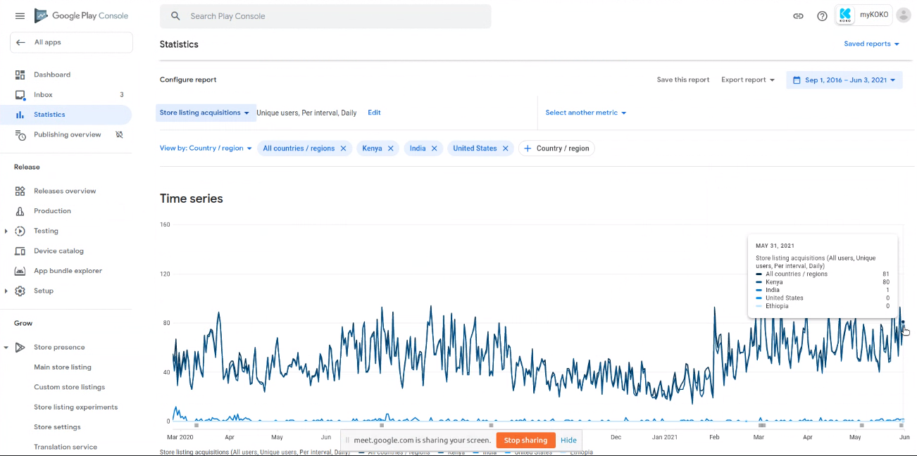
myKOKO Sales App - User Acquisitions

Slide 20
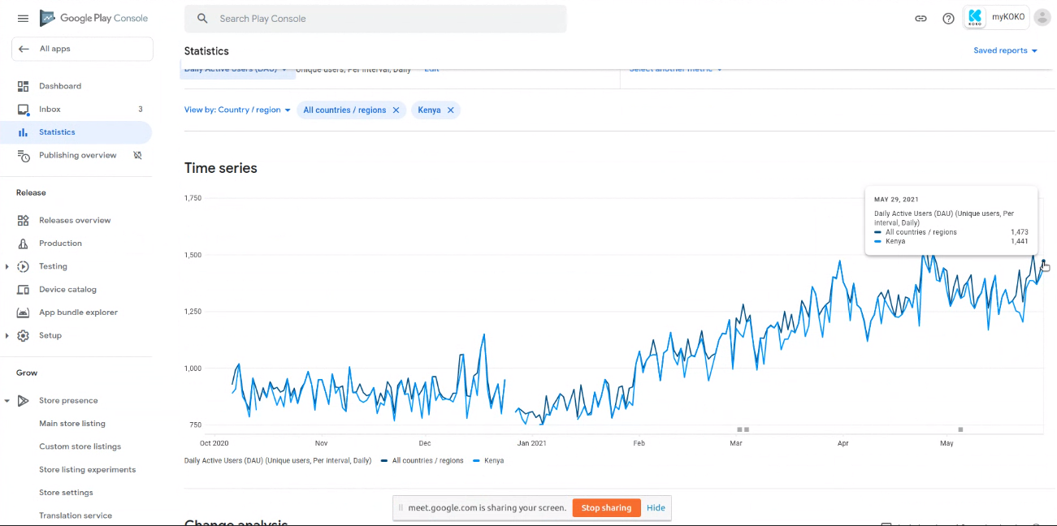
myKOKO Sales App - Daily Active Users

Slide 21
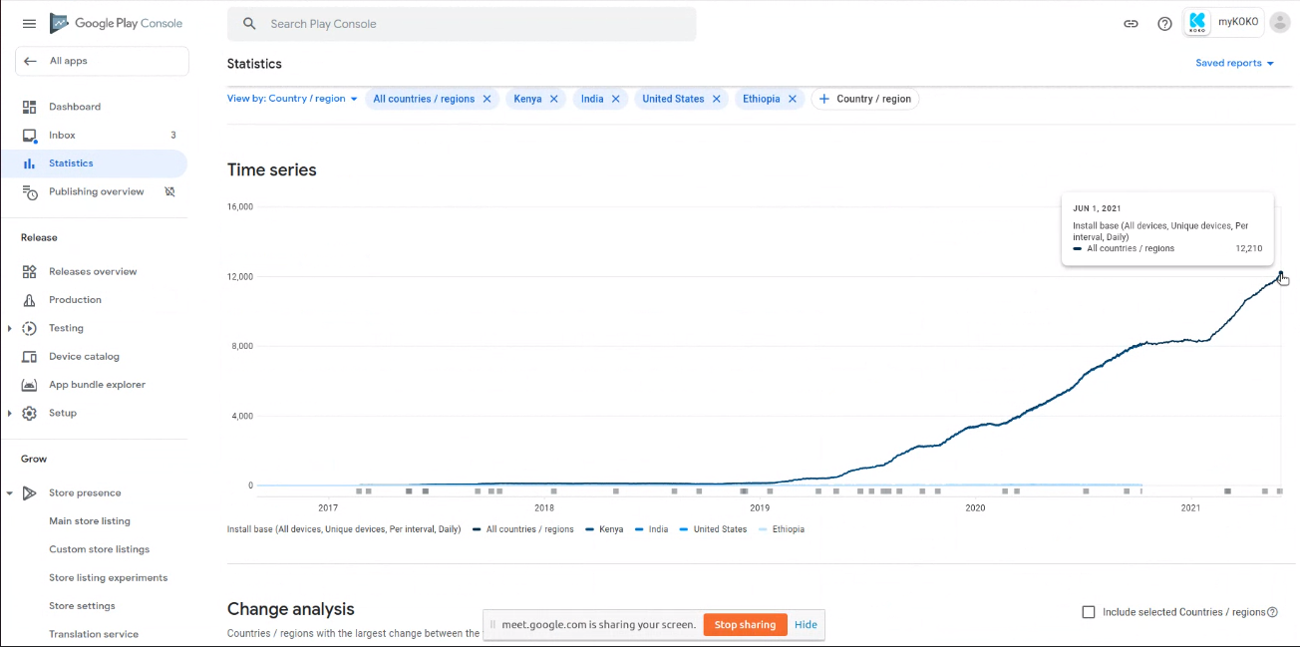
myKOKO Sales App - Install Base (All Devices)

Slide 22
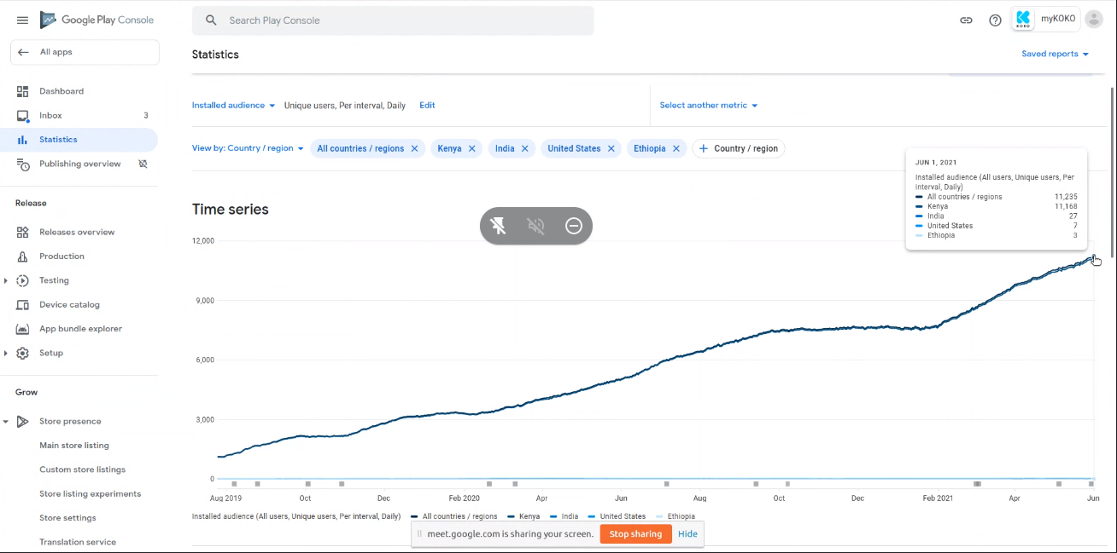
myKOKO Sales App - Install Base (Unique Users)

Slide 23
Operational Functional Gaps
NETWORK OPERATIONS
Planning for deployment operations is done entirely on Google sheets.
The QA team for civil works inspections rely on Google forms for reporting.
Agent shop inspection team takes photos on their phones and uploads them to Google drive.
There is no direct sharing of data between related functions.
Spreadsheet records can easily be corrupted, both intentionally and unintentionally.
Generating reports from spreadsheets is tedious and time consuming.

Slide 24
Operational Functional Gaps
COOKER OPERATIONS
The bulk synchronization of cooker kits with the ERP is faulty.
Reverse logistics has to be done manually.
There’s no check to ensure that clerks complete stocktaking in agent shops.
Cooker service technicians have to use Google sheets for planning field visits.
Cooker service teams manage their spare parts using Google sheets.
There are no instructional guides available to field service teams.
Documenting spare part and cooker kit serial numbers has to be done using WhatsApp in the field.
Technicians have to submit repair notes and comments into the service tracker spreadsheet.
Replacing faulty canisters or cooker kits is done through Customer Care.
It is difficult to track part movement using spreadsheets.

Slide 25
Operational Functional Gaps
AGENT NETWORKS
KOKO agents have no visibility of their sales figures
KOKO agents have no visibility of customers they have recruited
KOKO agents have no visibility of their active leads
KOKO agents have no visibility of their expiring leads
KOKO agents have no visibility of their performance vs targets
KOKO agents have no visibility of their fuel sales
KOKO agents have no visibility of their monthly performance ranking
SMS is not an effective communication tool due to the character length limitation.
The Agent sales team has no internal tool for sending agent sales targets and alerts.
Agents have to use Google sheets to capture leads information.
Agents have to use WhatsApp groups to communicate with the support team at KOKO
Reporting is time consuming and difficult when using Google Sheets to capture data.

Slide 26
Operational Functional Gaps
FUEL OPERATIONS
Fuel quality measurement at fuel depots is manual and results must be sent to KOKO using WhatsApp.
There’s no performance monitoring tool for fuel operators
Process delays requiring escalation can cause unnecessary delays to both operators and KOKO agents
Operators have no issue reporting tool and have to make phone calls to get support
CUSTOMER CARE
Agents use a WhatsApp group to support the Field Service team.
Agents process field data like kit serial numbers, kit transfers etc manually.
CUSTOMER SALES
Agents manage sales leads using Google sheets.
Sales planning and agent assignments are managed using Google sheets
Agent performance monitoring is done manually

Slide 27
Mobile Apps Pain Points
APPSHEET (3RD PARTY)
AppSheet is limited in functionality and doesn’t integrate with KOKO systems
Calibration data have to be copied manually into KOKO Core
AppSheet relies on Google Sheets to work
WHATSAPP (3RD PARTY)
WhatsApp features are limited for KOKO operational requirements
WhatsApp data like chats are stored outside KOKO systems
Processing part and kit serial numbers using WhatsApp is slow and tedious
WhatsApp doesn’t have capabilities for sharing data with KOKO Core

Slide 28
Mobile Apps Pain Points
myKOKO SALES APP
myKOKO app has limited features for both retail customers and KOKO agents.
myKOKO app experiences frequent MPESA transaction failures
myKOKO app users cannot modify their phone number within the app
In-app notification within the app impedes app usage
Some new users experience issues when registering new phone numbers
There is no option for topping up in the home screen
myKOKO app experiences frequent app freezes
KOKO OPERATOR APP (KOA)
KOA has limited functionalities for fuel operators.
Fuel operators have no reporting features within KOA.
Fuel operators can’t flag issues within the KOA app.
Fuel operators don’t have the ability to rearrange scheduled tasks within KOA.

Slide 29
Mobile Apps Pain Points
KOKO MILE APP
Frequent synchronization failures with the ERP when scanning cooker kits
Complete stocktaking of cooker kits in agent shops is not enforced within the app
Fuel operators can’t perform reverse logistics within the app
KOKO WAREHOUSE OPERATIONS APP
Frequent synchronization issues with the ERP when scanning kits
Bulk scanning of cooker kits is broken
KOKO LOADING OPERATIONS APP
Frequent synchronization issues with the ERP when scanning kits
Bulk scanning of cooker kits is broken

Slide 30
Mobile App Requirements
NETWORK OPERATIONS
The mobile app should be able to update the deployment planning schedule from the field.
The mobile app should have capabilities for inspecting civil works in the field.
The mobile app should provide tools for performing Agent shop inspections.
The mobile app should be able to update the quality planning schedule from the field.
The mobile app should provide scheduling management capabilities
FUEL OPERATIONS
The mobile app should be able to perform fuel quality measurement at fuel depots
The mobile app should be able to perform performance monitoring for operators
The mobile app should be able to send issue reports to fuel operations
The mobile app should be able to receive updates from fuel operations

Slide 31
Mobile App Requirements
COOKER OPERATIONS
The mobile app should be able to perform reverse logistics
The mobile app will ensure that stocktaking is completed for all kits in agent shops
The mobile app shall ensure that all kits synchronize successfully with the ERP
The mobile app shall provide field visit previews to field service teams
The mobile app shall provide scheduling capabilities for field service teams
The mobile app shall provide field service technicians with information on spares in their toolboxes
The mobile app shall provide instruction guides to field technicians for performing cooker repairs
The mobile app should enable field technicians to update spare part serial numbers in KOKO Core
The mobile app should enable field technicians to submit notes and comments on repairs to KOKO Core
The mobile app should enable field technicians to swap cooker kits in KOKO Core
The mobile app should enable field technicians to reassign fuel canisters in KOKO Core

Slide 32
Mobile App Requirements
AGENT NETWORKS
The mobile app shall provide information on the agent’s active leads
The mobile app shall provide information on the agent’s expiring leads
The mobile app shall provide information on the agent’s savings orders
The mobile app shall provide information on the agent’s paid orders
The mobile app shall provide information on the agent’s sales
The mobile app shall provide information on the agent’s cancelled orders
The mobile app shall provide information on customers recruited by an agent
The mobile app shall provide information on the agent’s monthly performance
The mobile app shall provide information on the agent’s monthly targets
The mobile app shall provide information on the agent’s fuel sales
The mobile app shall provide information on the agent’s monthly performance ranking (gold, silver, bronze)
The mobile app shall enable Agent sales to send alerts to agents
The mobile app shall enable Expansion team to send reports to KOKO Core

Slide 33
Mobile App Improvements
myKOKO SALES APP
Modify the app to cater solely to retail consumers in order to improve the user experience.
Improve the MPESA transaction process reporting to app users.
Provide app users with the ability to change their phone number within the app.
Improve the in-app notification to prevent it from impeding app usage.
Improve phone number authentication for new registrations.
Improve app performance to eradicate app freezes.

Slide 34
Mobile App Improvements
KOKO OPERATOR APP
Fuel operators should be able to submit fuel quality tests at the fuel depots.
Perform operator performance monitoring within the app.
Operators should be able to report issues for support in the field.
Send notifications or alerts to operators in the field.
Allow operators to rearrange their scheduled tasks.
KOKO MILE APP
Fix the bulk synchronization issue with the ERP for cooker kit scanning.
Enforce complete stocktaking of cooker kits in Agent shops.
Enable operators to perform reverse logistics within the app.

Slide 35
New Mobile App Proposals
PROPOSED TITLE
KOKO Agent app
PRIORITY
High
KOKO OPERATION
Agent Networks
SUMMARY
The app is intended to serve KOKO agents as their direct interface with KOKO Networks. It will have agent related features for managing their profiles, viewing information related to their agent shop and customers, as well as transaction capabilities.

Slide 36
New Mobile App Proposals
REQUIREMENTS
The mobile app shall provide information on the agent’s active leads
The mobile app shall provide information on the agent’s expiring leads
The mobile app shall provide information on the agent’s savings orders
The mobile app shall provide information on the agent’s paid orders
The mobile app shall provide information on the agent’s sales
The mobile app shall provide information on the agent’s cancelled orders
The mobile app shall provide information on customers recruited by an agent
The mobile app shall provide information on the agent’s monthly performance
The mobile app shall provide information on the agent’s monthly targets
The mobile app shall provide information on the agent’s fuel sales
The mobile app shall provide information on the agent’s monthly performance ranking (gold, silver, bronze)
The mobile app shall enable Agent sales to send alerts to agents

Slide 37
New Mobile App Proposals
PROPOSED TITLE
Cooker Service app
PRIORITY
High
KOKO OPERATION
Cooker Operations
SUMMARY
This app is intended to assist cooker service technicians in performing cooker repairs in the field. The application will provide the technicians with a preview of their planned field visits, scheduling field visits from customer support tickets, updating visit information in support tickets, scanning spare part swaps into KOKO Core, replacing cooker kits and canisters in KOKO Core, and receiving alerts and notifications from Customer Care.

Slide 38
New Mobile App Proposals
REQUIREMENTS
The mobile app should be able to perform reverse logistics
The mobile app will ensure that stocktaking is completed for all kits in agent shops
The mobile app shall ensure that all kits synchronize successfully with the ERP
The mobile app shall provide field visit previews to field service teams
The mobile app shall provide scheduling capabilities for field service teams
The mobile app shall provide field service technicians with information on spares in their toolboxes
The mobile app shall provide instruction guides to field technicians for performing cooker repairs
The mobile app should enable field technicians to update spare part serial numbers in KOKO Core
The mobile app should enable field technicians to submit notes and comments on repairs to KOKO Core
The mobile app should enable field technicians to swap cooker kits in KOKO Core
The mobile app should enable field technicians to reassign fuel canisters in KOKO Core

Slide 39
New Mobile App Proposals
PROPOSED TITLE
KP Service app
PRIORITY
Medium
KOKO OPERATION
Cooker Operations
SUMMARY
This app is intended to assist in managing KOKOpoint service at agent shops. Such services include KP maintenance, Quality Assurance and KP calibration. The app is intended as a replacement for third party apps like AppSheet, which manage service data outside KOKO Core and doesn’t share information with other KOKO applications.

Slide 40
New Mobile App Proposals
REQUIREMENTS
The mobile application should provide schedule management capabilities for the KP maintenance team.
The mobile application should provide schedule management capabilities for the calibration team.
The mobile application should allow the maintenance team to update the planning schedule from the field
The mobile application should allow the calibration team to update the planning schedule from the field
The mobile application should enable the field maintenance team with reporting capabilities
The mobile application should enable the calibration team with reporting capabilities

Slide 41
New Mobile App Proposals
PROPOSED TITLE
Shop Inspection app
PRIORITY
Medium
KOKO OPERATION
Network Operations
SUMMARY
This app is intended to assist in 2 KOKO operations, i.e. Agent shop civil works and Agent shop inspection. The app will assist KOKO staff to inspect proposed agent shops for qualification, as well as supervising shop civil works, whether by KOKO staff or by contractors.

Slide 42
New Mobile App Proposals
REQUIREMENTS
The mobile application should be able to assist in planning civil works operations
The mobile application should be able to assist in planning shop inspection operations
The QA team should be able to perform civil works inspections using the mobile application
Agent inspection team should be able to capture shop inspection data directly into the mobile application
The QA team should be able to manage their inspection schedules using the mobile application
The QA team should be able to submit inspection reports using the mobile application
The inspection team should be able to manage their inspection schedules using the mobile application
The inspection team should be able to submit inspection reports using the mobile application

Slide 43
Roadmap Proposals
MYKOKO FEATURE IMPROVEMENTS | TIMELINE | PRIORITY
Improve the app performance to eliminate app freezes | Q3 | HIGH
Improve customer notification display to prevent it from impeding app usage | Q3 | HIGH
Improve the registration process to prevent phone number rejection by KOKO Core | Q3 | HIGH
Remove agent related features from myKOKO sales app | Q4 | MEDIUM
Improve MPESA transaction workflow to improve the user experience | Q4 | MEDIUM
Change/modify customer phone number within the app | Q4 | MEDIUM

Slide 44
Roadmap Proposals
KOKO OPERATOR APP IMPROVEMENTS | TIMELINE | PRIORITY
Report issues to KOKO support using the KOA app | Q3 | HIGH
Send notifications and alerts to fuel operators through KOA | Q3 | HIGH
Submit fuel quality tests at fuel depots within the app | Q4 | MEDIUM
Monitor operator performance and create performance reports | Q4 | MEDIUM
Manage individual refueling schedules within the app | Q4 | MEDIUM

Slide 45
Roadmap Proposals
KOKO MILE APP IMPROVEMENTS | TIMELINE | PRIORITY
Fix bulk synchronization of cooker kits with KOKO ERP | Q3 | HIGH
Enforce complete stocktaking of cooker kits in Agent shops | Q3 | HIGH
Perform reverse logistics of cooker kits within the app | Q4 | MEDIUM

Slide 46
Roadmap Proposals
MOBILE APP | SUMMARY | TIMELINE | PRIORITY
KOKO Agent app | This app is intended to provide a self service platform for KOKO agents. It should have agent related features for managing their profiles, viewing information related to their agent shop and customers, as well as transaction capabilities. | Q3 | HIGH
Cooker Service app | This app is intended to assist cooker service technicians in performing repairs in the field. Features include schedule management, reporting, part scanning etc. | Q3 | HIGH
KP Service app | This app is intended to assist in managing KOKOpoint service at agent shops. Such services include KP maintenance, Quality Assurance and KP calibration. | Q4 | MEDIUM
Shop Inspection app | This app is intended to assist in agent shop civil works as well as agent shop inspection. The app should also be useful in sending reports back to KOKO. | Q4 | MEDIUM

Slide 47
k.nyawallow@kokonetworks.com

